Slide 1
Interpolation
Topic: Spline Interpolation Method
Major: General

Slide 2
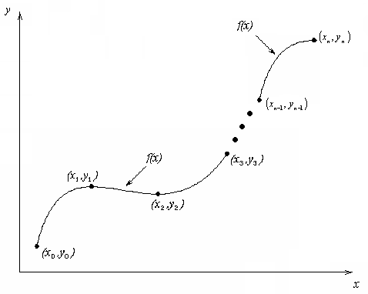
What is Interpolation ?
Given (x₀,y₀), (x₁,y₁), …… (x_{n},y_{n}), find the value of ‘y’ at a value of ‘x’ that is not given.

Slide 3

Interpolants
Polynomials are the most common choice of interpolants because they are easy to:
  Evaluate
  Differentiate, and
  Integrate.

Slide 4
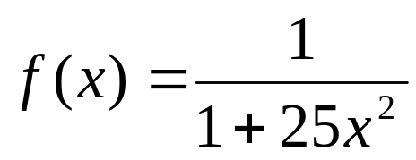
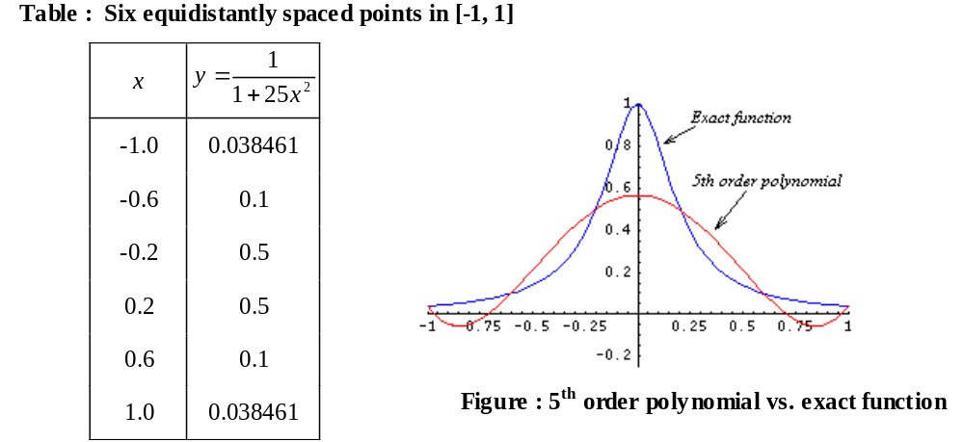
Why Splines ?

Slide 5
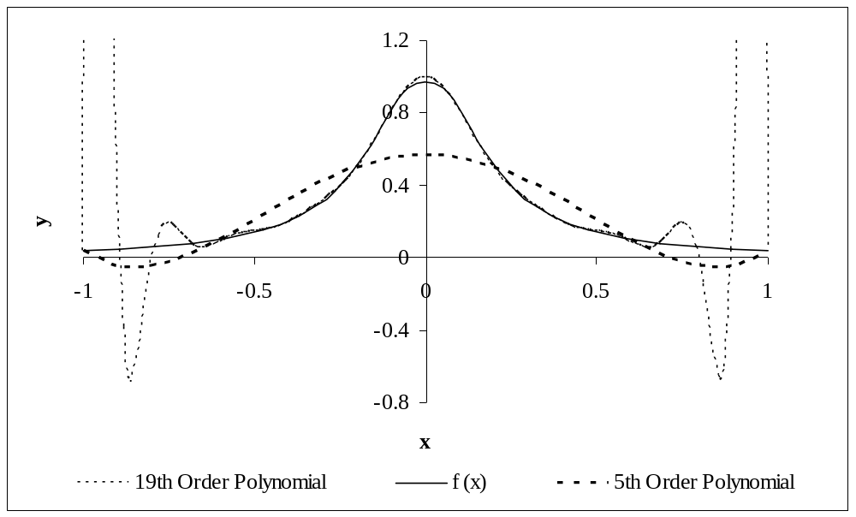
Why Splines ?
Figure : Higher order polynomial interpolation is a bad idea

Slide 6
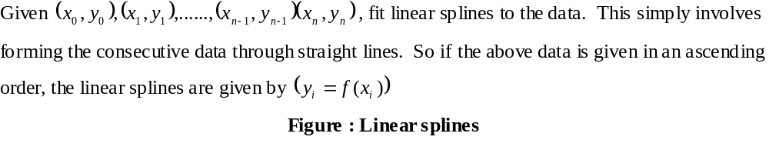
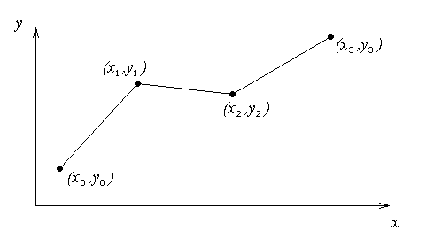
Linear Interpolation

Slide 7
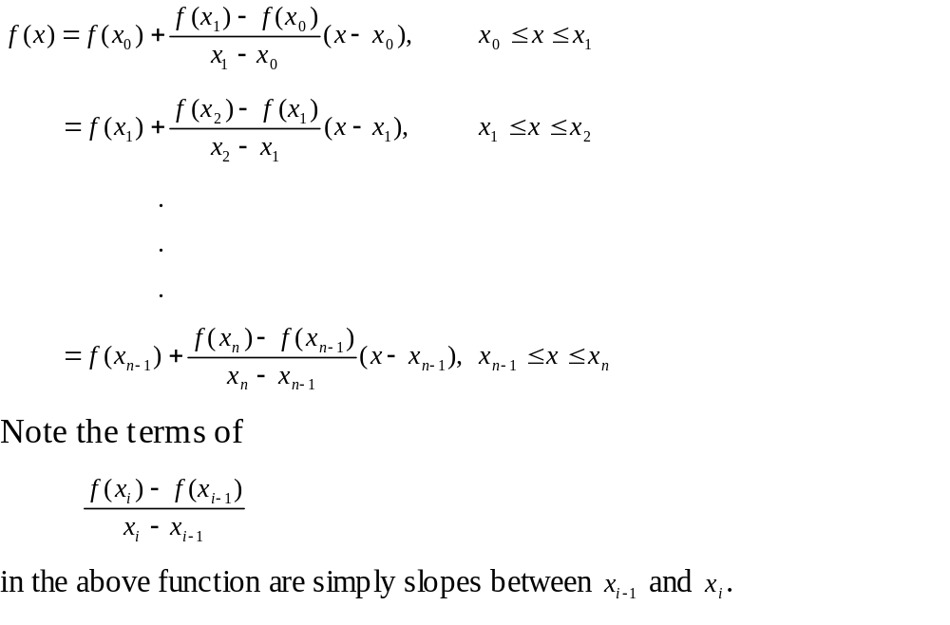
Linear Interpolation (contd)

Slide 8
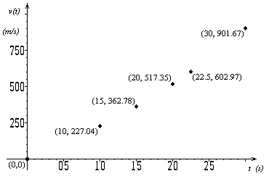

Example
The upward velocity of a rocket is given as a function of time in Table 1. Find the velocity at t=16 seconds using linear splines.
t | v(t)
s | m/s
0 | 0
10 | 227.04
15 | 362.78
20 | 517.35
22.5 | 602.97
30 | 901.67
Figure : Velocity vs. time data
for the rocket example
Table : Velocity as a
function of time

Slide 9
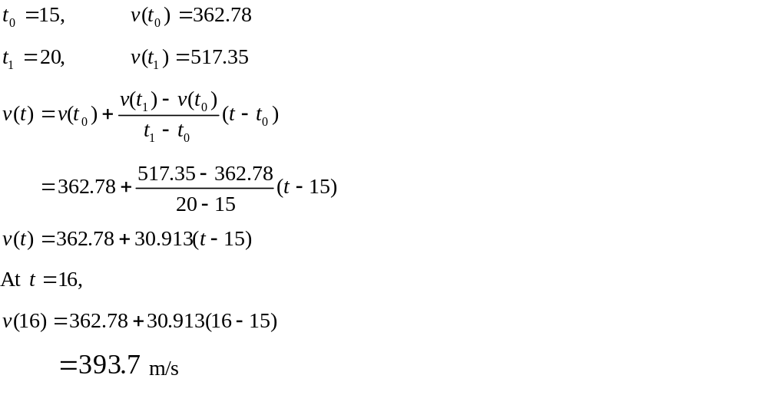
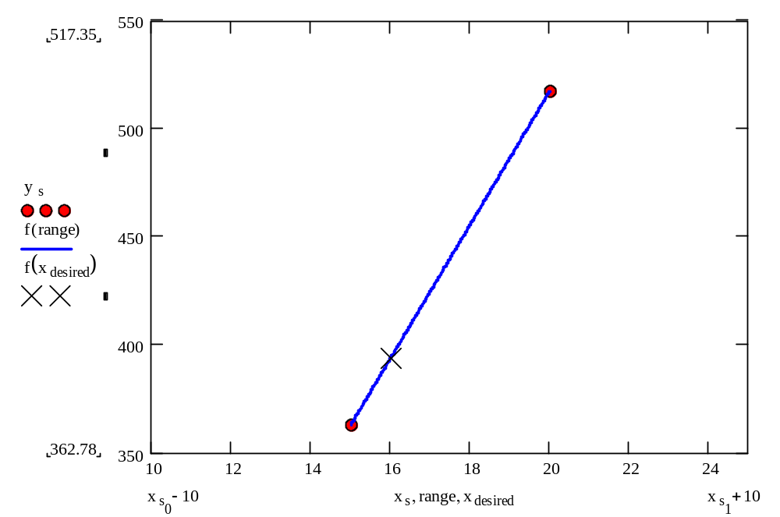
Linear Interpolation

Slide 10
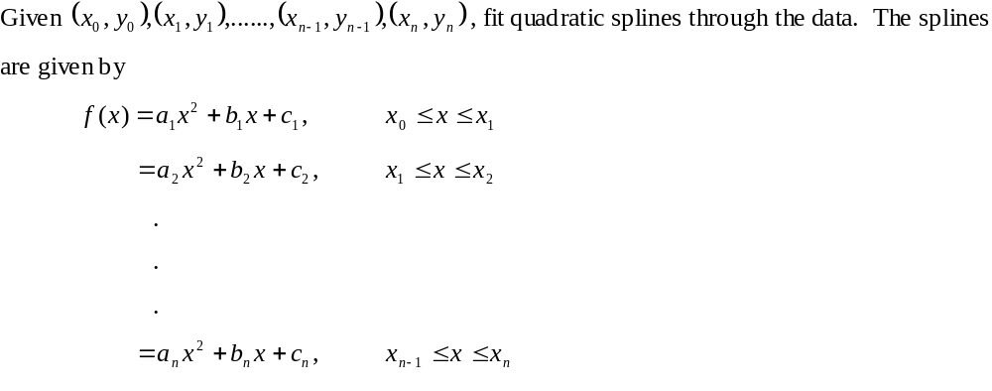
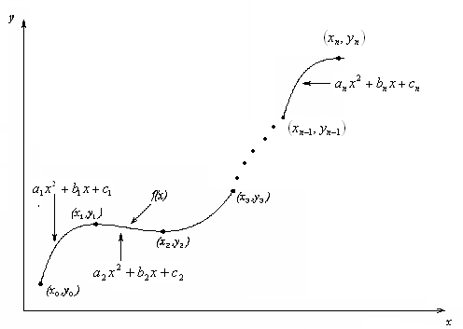
Quadratic Interpolation

Slide 11
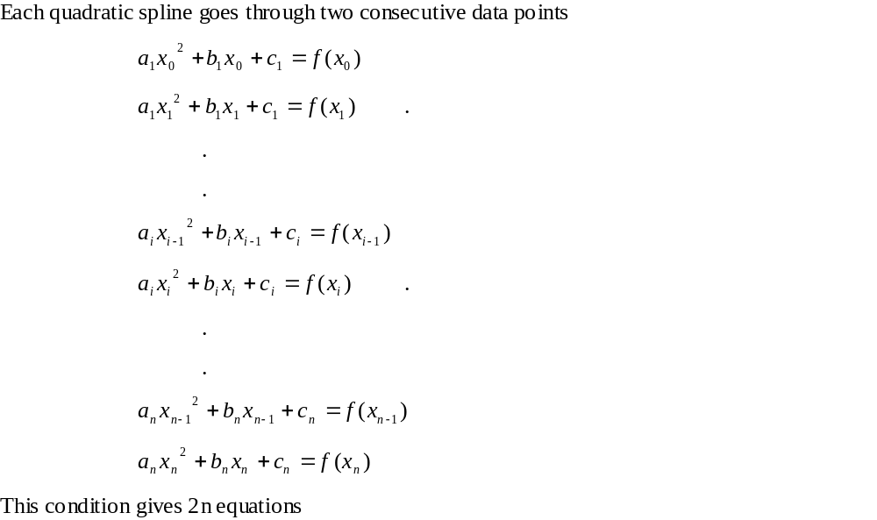
Quadratic Interpolation (contd)

Slide 12
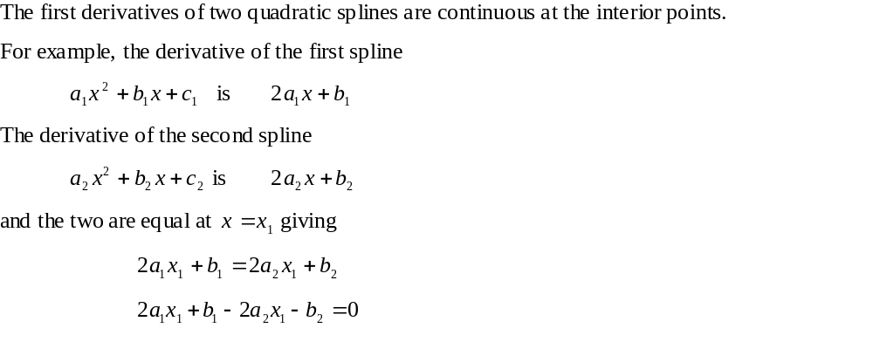
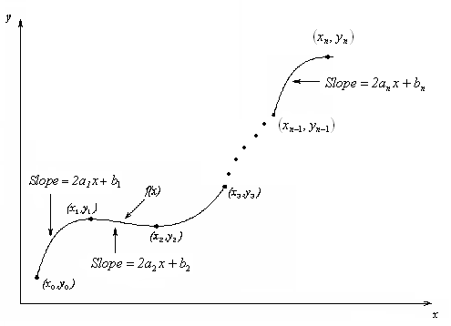
Quadratic Splines (contd)

Slide 13
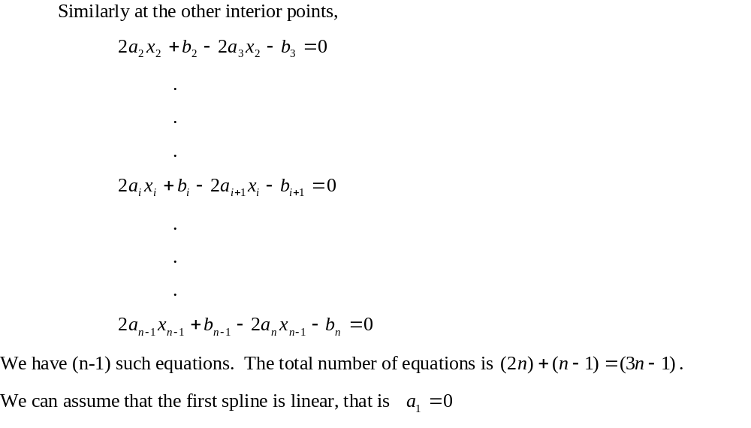
Quadratic Splines (contd)

Slide 14
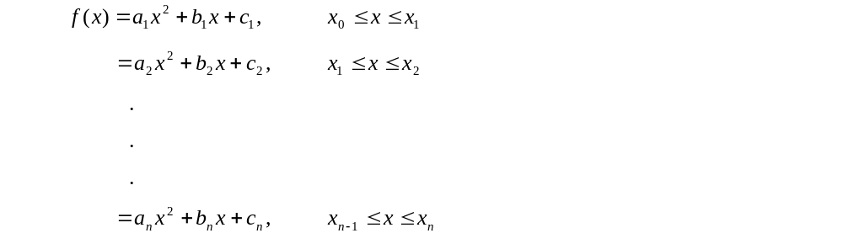
Quadratic Splines (contd)

Slide 15
Example
The upward velocity of a rocket is given as a function of time in Table 1. Find the velocity at t=16 seconds using quadratic splines.
t | v(t)
s | m/s
0 | 0
10 | 227.04
15 | 362.78
20 | 517.35
22.5 | 602.97
30 | 901.67
Figure : Velocity vs. time data
for the rocket example
Table : Velocity as a
function of time

Slide 16
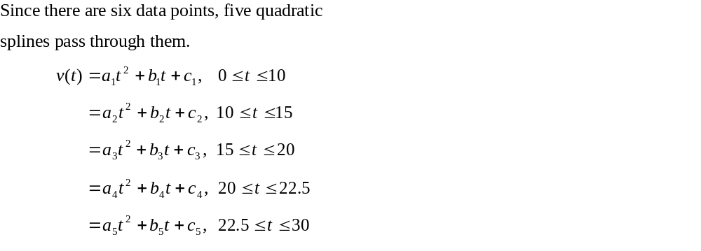
Solution

Slide 17
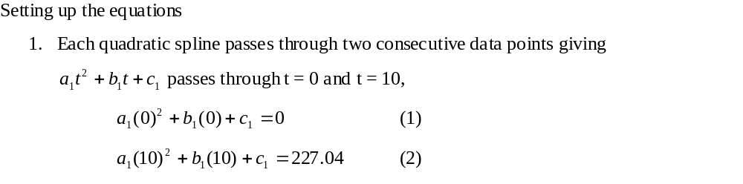
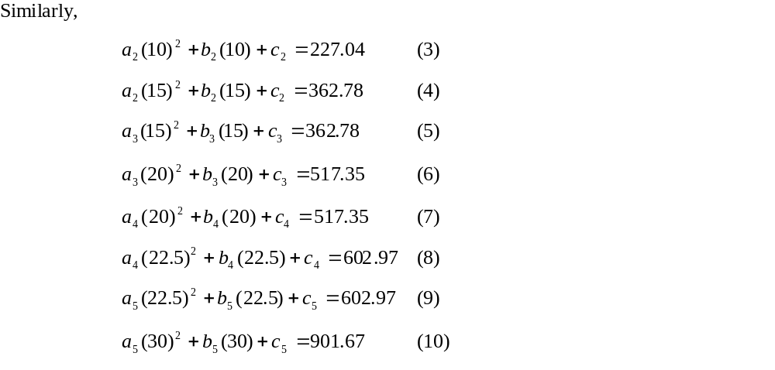
Solution (contd)

Slide 18
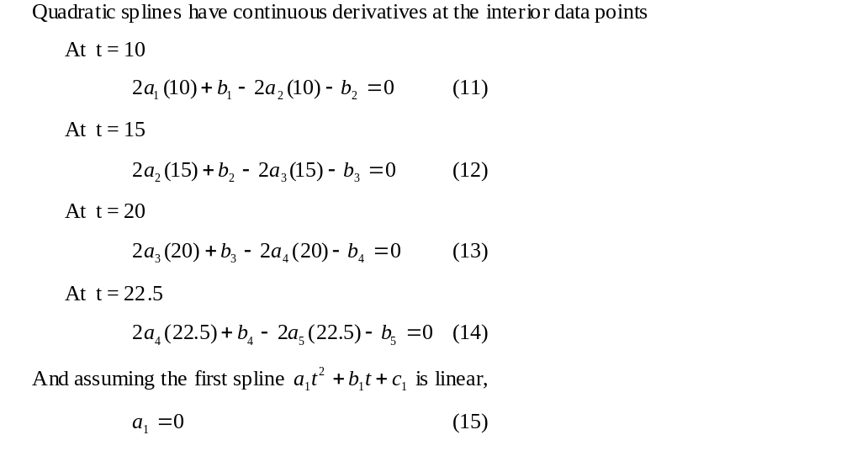
Solution (contd)

Slide 19
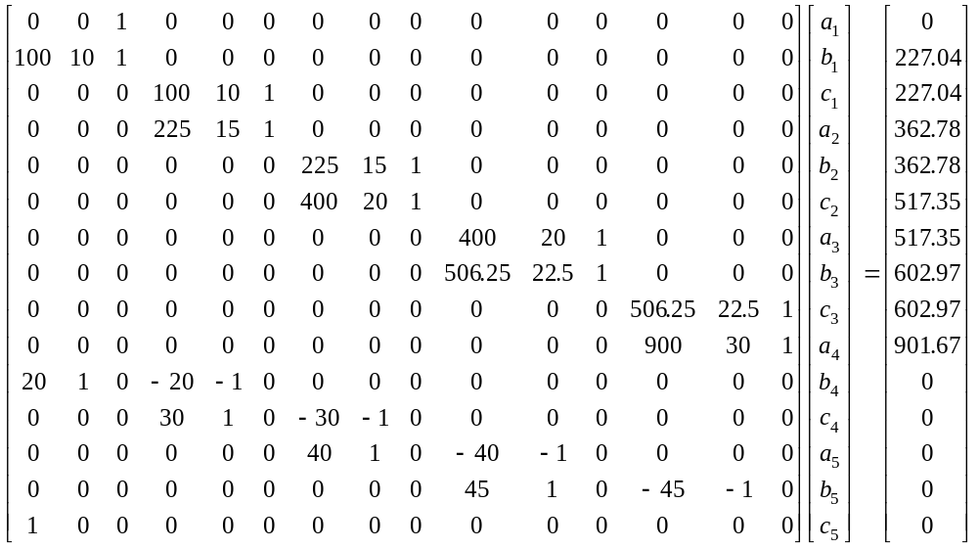
Solution (contd)

Slide 20
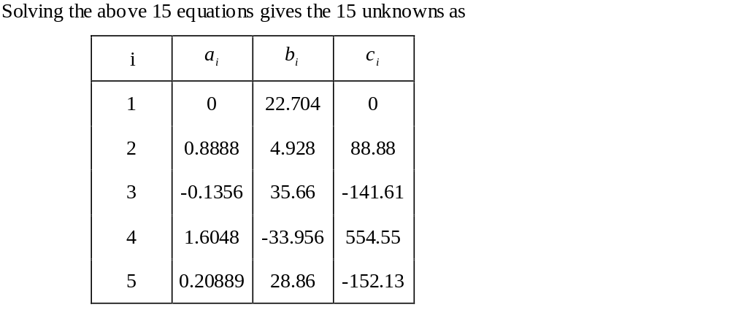
Solution (contd)

Slide 21
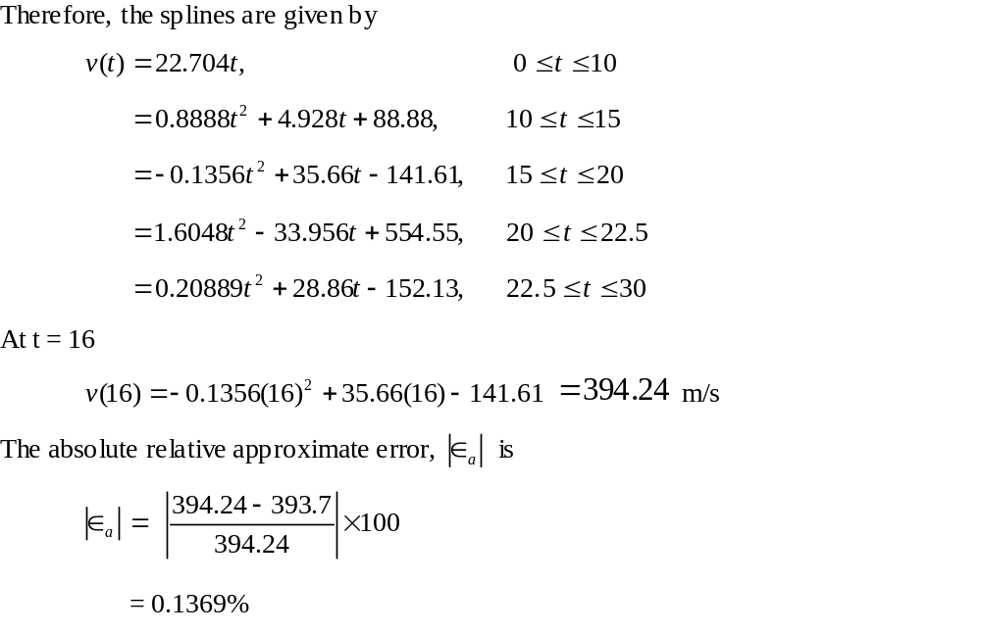
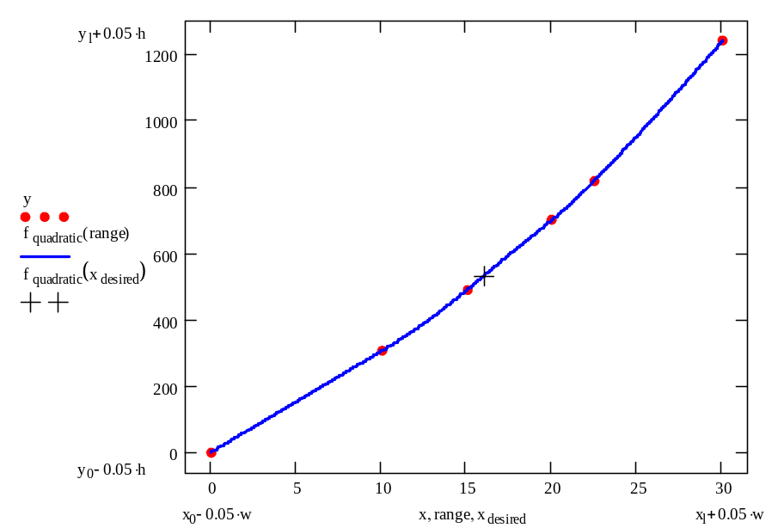
Solution (contd)

Slide 22
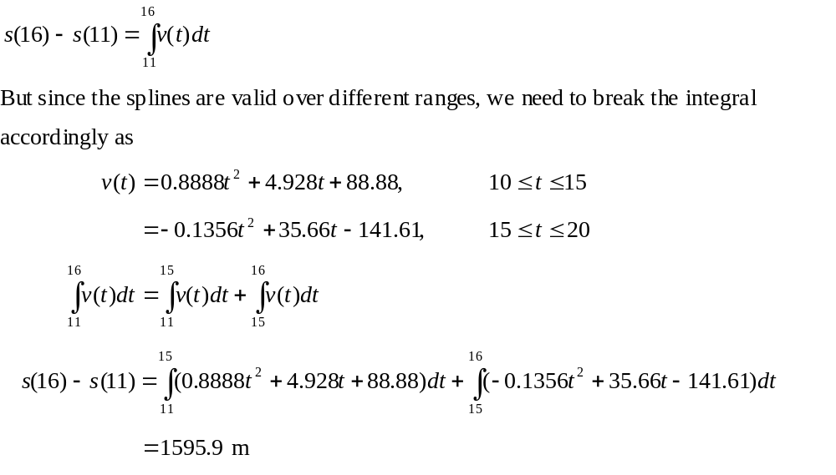
Distance from Velocity Profile
Find the distance covered by the rocket from t=11s to
t=16s

Slide 23
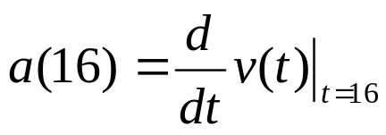
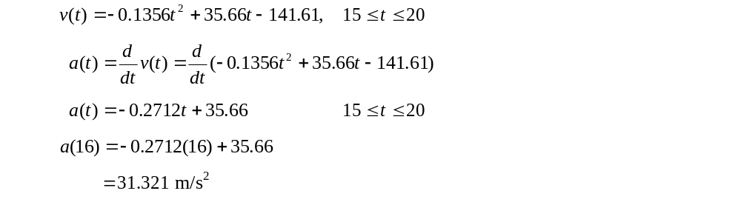
Acceleration from Velocity Profile
Find the acceleration of the rocket at t=16s.
The quadratic spline valid at t=16 is given by
,

